Slide 1
Dedoop: Efficient Deduplication with Hadoop
Lars Kolb

Slide 2
Entity Resolution
ER
Identification of duplicate entities
Pairwise comparisons → O(n²)
Application of several costly similarity measures
Blocking
Grouping of entities that are “somehow similar"
Comparisons restricted to entities from the same block

Slide 3
Entity Resolution (2)
Training Data ⊆ R×S
R |  |  | S |  |  | match
A₁ | … | A_{u} | A₁ | … | A_{v}
… | … | … | … | … | … | true
… | … | … | … | … | … | false
Phase 1: Training
Training Similarities
Parallelization &
Distributed Computation!
MapReduce!
sim₁ | … | sim_{k} | match
0.8 | … | 0.7 | true
0.4 | … | 0.6 | false
a₁ ⋅ sim₁+ a₂ ⋅ sim₂ …+a_{k} ⋅ sim_{k} > t ?
Similarity computation
Classifier Training
R
B₁
Blocking
Similarity computation
id_{R} | id_{S} | sim₁ | … | sim_{k} | match
... | ... | 0.5 | … | 0.6 | ?
... | ... | 0.8 | … | 0.9 | ?
Match decision
B₂
S
Classifier
B₃
Phase 2: Application
Match Result
(id_{R}, id_{S})
Costly , due to
Expensive Similarity functions
O(n²) per block

Slide 4
Outline
Motivation
Entity Resolution with MapReduce
Dedoop
Browser-based workflow specification
Workflow submission & progress monitoring
Load-balancing
Hadoop@EC2
Summary

Slide 5
Entity Resolution with MapReduce
Programming model for distributed computation in cluster environments
Map determines blocking keys for each entity and outputs (blockkey, entity) pairs
Reduce compares entities that belong to the same block
0
reduce₀
$Π$₀’
1
$Π$₀
map₀
Input data
2
reduce₁
$Π$₁’
$Π$₁
map₁
part(key) → [0, r-1]
0
1
$Π$₂
map₂
2
$Π$₂’
reduce₂
Map tasks
(m=3)
1
0
reduce tasks
(r=3)
Notes:
Computation expressed by two UDFs
Contain sequential code
Executed in parallel among multiple nodes
map: (key_{in}, value_{in}) → list(key_{tmp}, value_{tmp})
reduce: (key_{tmp}, list(value_{tmp})) → list(key_{out}, value_{out})
Computation relies on data partitioning and redistribution
Number of map tasks m and reduce tasks r
Task executed by some idle node in the cluster
UDF part partitions map output and distributes it to the r reduce tasks
Sorting of key-value pairs
Grouping of key-value pairs by key and invocation of reduce for each group

Slide 6
Entity Resolution with MapReduce (2)
MapReduce workflows “hard coded”
Multiple predefined MapReduce Jobs
map, reduce, part, sort, and group functions
Key and value classes, Input & OutputFormat classes
Packaged in single jar archive (=Kernel)
CLI-based “Interaction”
Copy input data to DFS: hadoop dfs -copyFromLocal localfile remotedir
Workflow execution: hadoop -jar Kernel.jar <params>
Copy output data from DFS to local disk for durther processing
And …

Slide 7
Enormous parameterization effort
de.uni_leipzig.dbs.cloud_matching.map_reduce.preprocess.idf.IDF -Dmapred.input.dir=hdfs://master/input_data/DBLP.csv -Dweka.classifier=weka.classifiers.trees.LMT -Dmatching.blocking.key.generators.0.matching.tokenizer.ngram.n=3 -Dmatching.blocking.key.generators=de.uni_leipzig.dbs.cloud_matching.map_reduce.record.blocking.Tokenize,de.uni_leipzig.dbs.cloud_matching.map_reduce.record.blocking.Suffix -Dmatching.blocking.key.generators.0.matching.attribute.tokenizer=de.uni_leipzig.dbs.cloud_matching.map_reduce.record.tokenize.NgramTokenizer -Dattributes.mapping=1,1,2,2,4,4 -Dattribute.id.range=0 -Dmapred.output.dir=hdfs://master/out -Dmatching.generate.stats=false -Dmatching.blocking.key.generators.0.matching.blocking.key.normalizers=de.uni_leipzig.dbs.cloud_matching.map_reduce.record.normalize.LowerCase,de.uni_leipzig.dbs.cloud_matching.map_reduce.record.normalize.Punctuation,de.uni_leipzig.dbs.cloud_matching.map_reduce.record.normalize.Trim,de.uni_leipzig.dbs.cloud_matching.map_reduce.record.normalize.Whitespaces -Dfs.default.name=hdfs://master:8020 -Dmatching.matcher=de.uni_leipzig.dbs.cloud_matching.map_reduce.matching.WekaClassificationMatcher -Dattribute.id=0 -Dmatching.blocking.key.generators.0.matching.blocking.key.attributes=1 -Dmatching.dual.source=true -Dredundancy.handling=true -Dlearning.training.data.file.csv.header=true -Dmatching.blocking.key.generators.1.matching.blocking.key.attributes=2 -Dmatching.attributes.in.result=1,4 -Dmatching.similarity.functions=de.uni_leipzig.dbs.cloud_matching.map_reduce.matching.Levenshtein,de.uni_leipzig.dbs.cloud_matching.map_reduce.matching.TFIDFSimilarity -Dcsv.header.range=true -Dmapred.job.tracker=master:8021 -Dcsv.header.domain=true -Dmapred.input.dir.range=hdfs://master/input_data/GoogleScholar.csv -Dmatching.blocking.key.generators.1.matching.blocking.key.suffix.length=3 -Dmatching.attributes.used=1,1 -Dattributes.normalizers=de.uni_leipzig.dbs.cloud_matching.map_reduce.record.normalize.LowerCase,de.uni_leipzig.dbs.cloud_matching.map_reduce.record.normalize.Punctuation,de.uni_leipzig.dbs.cloud_matching.map_reduce.record.normalize.Trim,de.uni_leipzig.dbs.cloud_matching.map_reduce.record.normalize.Whitespaces -Dmatching.attributes.in.result.names=dblp_title_1,dblp_year_1,gs_title_2,gs_year_2 -Dlearning.training.data.file=hdfs://master/input_data/train_500_1.csv -Dmatching.blocking.key.generators.1.matching.blocking.key.normalizers=de.uni_leipzig.dbs.cloud_matching.map_reduce.record.normalize.LowerCase,de.uni_leipzig.dbs.cloud_matching.map_reduce.record.normalize.Punctuation,de.uni_leipzig.dbs.cloud_matching.map_reduce.record.normalize.Trim,de.uni_leipzig.dbs.cloud_matching.map_reduce.record.normalize.Whitespaces -Dmatching.blocking.key.generators.0.matching.tokenizer.ngram.fill=true de.uni_leipzig.dbs.cloud_matching.map_reduce.preprocess.learning_weka.WekaLearner -Dmapred.input.dir=hdfs://master/input_data/DBLP.csv -Dweka.classifier=weka.classifiers.trees.LMT -Dmatching.blocking.key.generators.0.matching.tokenizer.ngram.n=3 -Dmatching.blocking.key.generators=de.uni_leipzig.dbs.cloud_matching.map_reduce.record.blocking.Tokenize,de.uni_leipzig.dbs.cloud_matching.map_reduce.record.blocking.Suffix -Dmatching.blocking.key.generators.0.matching.attribute.tokenizer=de.uni_leipzig.dbs.cloud_matching.map_reduce.record.tokenize.NgramTokenizer -Dattributes.mapping=1,1,2,2,4,4 -Dattribute.id.range=0 -Dmapred.output.dir=hdfs://master/out -Dmatching.generate.stats=false -Dmatching.blocking.key.generators.0.matching.blocking.key.normalizers=de.uni_leipzig.dbs.cloud_matching.map_reduce.record.normalize.LowerCase,de.uni_leipzig.dbs.cloud_matching.map_reduce.record.normalize.Punctuation,de.uni_leipzig.dbs.cloud_matching.map_reduce.record.normalize.Trim,de.uni_leipzig.dbs.cloud_matching.map_reduce.record.normalize.Whitespaces -Dfs.default.name=hdfs://master:8020 -Dmatching.matcher=de.uni_leipzig.dbs.cloud_matching.map_reduce.matching.WekaClassificationMatcher -Dattribute.id=0 -Dmatching.blocking.key.generators.0.matching.blocking.key.attributes=1 -Dmatching.dual.source=true -Dredundancy.handling=true -Dlearning.training.data.file.csv.header=true -Dmatching.blocking.key.generators.1.matching.blocking.key.attributes=2 -Dmatching.attributes.in.result=1,4 -Dmatching.similarity.functions=de.uni_leipzig.dbs.cloud_matching.map_reduce.matching.Levenshtein,de.uni_leipzig.dbs.cloud_matching.map_reduce.matching.TFIDFSimilarity -Dcsv.header.range=true -Dmapred.job.tracker=master:8021 -Dcsv.header.domain=true -Dmapred.input.dir.range=hdfs://master/input_data/GoogleScholar.csv -Dmatching.blocking.key.generators.1.matching.blocking.key.suffix.length=3 -Dmatching.attributes.used=1,1 -Dattributes.normalizers=de.uni_leipzig.dbs.cloud_matching.map_reduce.record.normalize.LowerCase,de.uni_leipzig.dbs.cloud_matching.map_reduce.record.normalize.Punctuation,de.uni_leipzig.dbs.cloud_matching.map_reduce.record.normalize.Trim,de.uni_leipzig.dbs.cloud_matching.map_reduce.record.normalize.Whitespaces -Dmatching.attributes.in.result.names=dblp_title_1,dblp_year_1,gs_title_2,gs_year_2 -Dlearning.training.data.file=hdfs://master/input_data/train_500_1.csv -Dmatching.blocking.key.generators.1.matching.blocking.key.normalizers=de.uni_leipzig.dbs.cloud_matching.map_reduce.record.normalize.LowerCase,de.uni_leipzig.dbs.cloud_matching.map_reduce.record.normalize.Punctuation,de.uni_leipzig.dbs.cloud_matching.map_reduce.record.normalize.Trim,de.uni_leipzig.dbs.cloud_matching.map_reduce.record.normalize.Whitespaces -Dmatching.blocking.key.generators.0.matching.tokenizer.ngram.fill=true de.uni_leipzig.dbs.cloud_matching.map_reduce.blocking.standard_blocking.block_split.job1.BlockSplit1 -Dmapred.input.dir=hdfs://master/input_data/DBLP.csv -Dweka.classifier=weka.classifiers.trees.LMT -Dmatching.blocking.key.generators.0.matching.tokenizer.ngram.n=3 -Dmatching.blocking.key.generators=de.uni_leipzig.dbs.cloud_matching.map_reduce.record.blocking.Tokenize,de.uni_leipzig.dbs.cloud_matching.map_reduce.record.blocking.Suffix -Dmatching.blocking.key.generators.0.matching.attribute.tokenizer=de.uni_leipzig.dbs.cloud_matching.map_reduce.record.tokenize.NgramTokenizer -Dattributes.mapping=1,1,2,2,4,4 -Dattribute.id.range=0 -Dmapred.output.dir=hdfs://master/out -Dmatching.generate.stats=false -Dmatching.blocking.key.generators.0.matching.blocking.key.normalizers=de.uni_leipzig.dbs.cloud_matching.map_reduce.record.normalize.LowerCase,de.uni_leipzig.dbs.cloud_matching.map_reduce.record.normalize.Punctuation,de.uni_leipzig.dbs.cloud_matching.map_reduce.record.normalize.Trim,de.uni_leipzig.dbs.cloud_matching.map_reduce.record.normalize.Whitespaces -Dfs.default.name=hdfs://master:8020 -Dmatching.matcher=de.uni_leipzig.dbs.cloud_matching.map_reduce.matching.WekaClassificationMatcher -Dattribute.id=0 -Dmatching.blocking.key.generators.0.matching.blocking.key.attributes=1 -Dmatching.dual.source=true -Dredundancy.handling=true -Dlearning.training.data.file.csv.header=true -Dmatching.blocking.key.generators.1.matching.blocking.key.attributes=2 -Dmatching.attributes.in.result=1,4 -Dmatching.similarity.functions=de.uni_leipzig.dbs.cloud_matching.map_reduce.matching.Levenshtein,de.uni_leipzig.dbs.cloud_matching.map_reduce.matching.TFIDFSimilarity -Dcsv.header.range=true -Dmapred.job.tracker=master:8021 -Dcsv.header.domain=true -Dmapred.input.dir.range=hdfs://master/input_data/GoogleScholar.csv -Dmatching.blocking.key.generators.1.matching.blocking.key.suffix.length=3 -Dmatching.attributes.used=1,1 -Dattributes.normalizers=de.uni_leipzig.dbs.cloud_matching.map_reduce.record.normalize.LowerCase,de.uni_leipzig.dbs.cloud_matching.map_reduce.record.normalize.Punctuation,de.uni_leipzig.dbs.cloud_matching.map_reduce.record.normalize.Trim,de.uni_leipzig.dbs.cloud_matching.map_reduce.record.normalize.Whitespaces -Dmatching.attributes.in.result.names=dblp_title_1,dblp_year_1,gs_title_2,gs_year_2 -Dlearning.training.data.file=hdfs://master/input_data/train_500_1.csv -Dmatching.blocking.key.generators.1.matching.blocking.key.normalizers=de.uni_leipzig.dbs.cloud_matching.map_reduce.record.normalize.LowerCase,de.uni_leipzig.dbs.cloud_matching.map_reduce.record.normalize.Punctuation,de.uni_leipzig.dbs.cloud_matching.map_reduce.record.normalize.Trim,de.uni_leipzig.dbs.cloud_matching.map_reduce.record.normalize.Whitespaces -Dmatching.blocking.key.generators.0.matching.tokenizer.ngram.fill=true de.uni_leipzig.dbs.cloud_matching.map_reduce.blocking.standard_blocking.block_split.job2.BlockSplit2 -Dmapred.input.dir=hdfs://master/out -Dweka.classifier=weka.classifiers.trees.LMT -Dmatching.blocking.key.generators.0.matching.tokenizer.ngram.n=3 -Dmatching.blocking.key.generators=de.uni_leipzig.dbs.cloud_matching.map_reduce.record.blocking.Tokenize,de.uni_leipzig.dbs.cloud_matching.map_reduce.record.blocking.Suffix -Dmatching.blocking.key.generators.0.matching.attribute.tokenizer=de.uni_leipzig.dbs.cloud_matching.map_reduce.record.tokenize.NgramTokenizer -Dattributes.mapping=1,1,2,2,4,4 -Dmapred.output.dir=hdfs://master/out -Dmatching.generate.stats=false -Dmatching.blocking.key.generators.0.matching.blocking.key.normalizers=de.uni_leipzig.dbs.cloud_matching.map_reduce.record.normalize.LowerCase,de.uni_leipzig.dbs.cloud_matching.map_reduce.record.normalize.Punctuation,de.uni_leipzig.dbs.cloud_matching.map_reduce.record.normalize.Trim,de.uni_leipzig.dbs.cloud_matching.map_reduce.record.normalize.Whitespaces -Dfs.default.name=hdfs://master:8020 -Dmatching.matcher=de.uni_leipzig.dbs.cloud_matching.map_reduce.matching.WekaClassificationMatcher -Dmatching.blocking.key.generators.0.matching.blocking.key.attributes=1 -Dmatching.dual.source=true -Dredundancy.handling=true -Dlearning.training.data.file.csv.header=true -Dmatching.blocking.key.generators.1.matching.blocking.key.attributes=2 -Dmatching.attributes.in.result=1,4 -Dmatching.similarity.functions=de.uni_leipzig.dbs.cloud_matching.map_reduce.matching.Levenshtein,de.uni_leipzig.dbs.cloud_matching.map_reduce.matching.TFIDFSimilarity -Dcsv.header.range=true -Dmapred.job.tracker=master:8021 -Dcsv.header.domain=true -Dmapred.input.dir.range=hdfs://master/out -Dmatching.blocking.key.generators.1.matching.blocking.key.suffix.length=3 -Dmatching.attributes.used=1,1 -Dlearning.training.data.file=hdfs://master/input_data/train_500_1.csv -Dmatching.attributes.in.result.names=dblp_title_1,dblp_year_1,gs_title_2,gs_year_2 -Dattributes.normalizers=de.uni_leipzig.dbs.cloud_matching.map_reduce.record.normalize.LowerCase,de.uni_leipzig.dbs.cloud_matching.map_reduce.record.normalize.Punctuation,de.uni_leipzig.dbs.cloud_matching.map_reduce.record.normalize.Trim,de.uni_leipzig.dbs.cloud_matching.map_reduce.record.normalize.Whitespaces -Dmatching.blocking.key.generators.1.matching.blocking.key.normalizers=de.uni_leipzig.dbs.cloud_matching.map_reduce.record.normalize.LowerCase,de.uni_leipzig.dbs.cloud_matching.map_reduce.record.normalize.Punctuation,de.uni_leipzig.dbs.cloud_matching.map_reduce.record.normalize.Trim,de.uni_leipzig.dbs.cloud_matching.map_reduce.record.normalize.Whitespaces -Dmatching.blocking.key.generators.0.matching.tokenizer.ngram.fill=true de.uni_leipzig.dbs.cloud_matching.map_reduce.postprocess.match_quality.Quality -Dmapred.input.dir=hdfs://master/input_data/quality_perfect.csv -Dweka.classifier=weka.classifiers.trees.LMT -Dmatching.blocking.key.generators.0.matching.tokenizer.ngram.n=3 -Dmatching.blocking.key.generators=de.uni_leipzig.dbs.cloud_matching.map_reduce.record.blocking.Tokenize,de.uni_leipzig.dbs.cloud_matching.map_reduce.record.blocking.Suffix -Dmatching.blocking.key.generators.0.matching.attribute.tokenizer=de.uni_leipzig.dbs.cloud_matching.map_reduce.record.tokenize.NgramTokenizer -Dmapred.output.dir=hdfs://master/out -Dmatching.generate.stats=false -Dmatching.was.dual.source=true -Dmatching.blocking.key.generators.0.matching.blocking.key.normalizers=de.uni_leipzig.dbs.cloud_matching.map_reduce.record.normalize.LowerCase,de.uni_leipzig.dbs.cloud_matching.map_reduce.record.normalize.Punctuation,de.uni_leipzig.dbs.cloud_matching.map_reduce.record.normalize.Trim,de.uni_leipzig.dbs.cloud_matching.map_reduce.record.normalize.Whitespaces -Dfs.default.name=hdfs://master:8020 -Dmatching.matcher=de.uni_leipzig.dbs.cloud_matching.map_reduce.matching.WekaClassificationMatcher -Dmatching.blocking.key.generators.0.matching.blocking.key.attributes=1 -Dmatching.dual.source=true -Dredundancy.handling=true -Dlearning.training.data.file.csv.header=true -Dmatching.blocking.key.generators.1.matching.blocking.key.attributes=2 -Dmatching.attributes.in.result=1,4 -Dmatching.similarity.functions=de.uni_leipzig.dbs.cloud_matching.map_reduce.matching.Levenshtein,de.uni_leipzig.dbs.cloud_matching.map_reduce.matching.TFIDFSimilarity -Dcsv.header.range=true -Dmapred.job.tracker=master:8021 -Dcsv.header.domain=true -Dmapred.input.dir.range=hdfs://master/out/blocksplit2 -Dmatching.blocking.key.generators.1.matching.blocking.key.suffix.length=3 -Dmatching.attributes.used=1,1 -Dattributes.normalizers=de.uni_leipzig.dbs.cloud_matching.map_reduce.record.normalize.LowerCase,de.uni_leipzig.dbs.cloud_matching.map_reduce.record.normalize.Punctuation,de.uni_leipzig.dbs.cloud_matching.map_reduce.record.normalize.Trim,de.uni_leipzig.dbs.cloud_matching.map_reduce.record.normalize.Whitespaces -Dmatching.attributes.in.result.names=dblp_title_1,dblp_year_1,gs_title_2,gs_year_2 -Dlearning.training.data.file=hdfs://master/input_data/train_500_1.csv -Dmatching.blocking.key.generators.1.matching.blocking.key.normalizers=de.uni_leipzig.dbs.cloud_matching.map_reduce.record.normalize.LowerCase,de.uni_leipzig.dbs.cloud_matching.map_reduce.record.normalize.Punctuation,de.uni_leipzig.dbs.cloud_matching.map_reduce.record.normalize.Trim,de.uni_leipzig.dbs.cloud_matching.map_reduce.record.normalize.Whitespaces -Dmatching.blocking.key.generators.0.matching.tokenizer.ngram.fill=true
Example parameter list for a small two-sources match problem
Specification and order of (Preprocessing) MapReduce jobs (“driver classes”)
Output/input directories (job_{i+1} consumes output of job_{i})
Blocking key generation functions (+parameters)
Similarity metrics (+parameters)
Id attributes, output attributes, attribute mapping
Normalization
Match Rules/Training data & Classifier (+parameters)
Gold Standard for Quality evaluation

Slide 8
Dedoop Overview
General ER Workflow
T⊆ R×S ×[0,1]
Machine Learning
R
Blocking
Similarity Computation
Match Classification
M⊆ R×S
S
Decision Tree
Logistic Regression
SVM
…
Standard Blocking
Sorted Neighborhood
PPJoin+
…
Edit Distance
n-gram
TFIDF
…
Threshold
Match rules
ML model
…
Kernel
Blocking Key Generators
Prefix
Token-based
…
Classifier
Training Job
Data
Analysis Job
Blocking-based Matching Job
General Dedoop‘s MapReduce Workflow

Slide 9
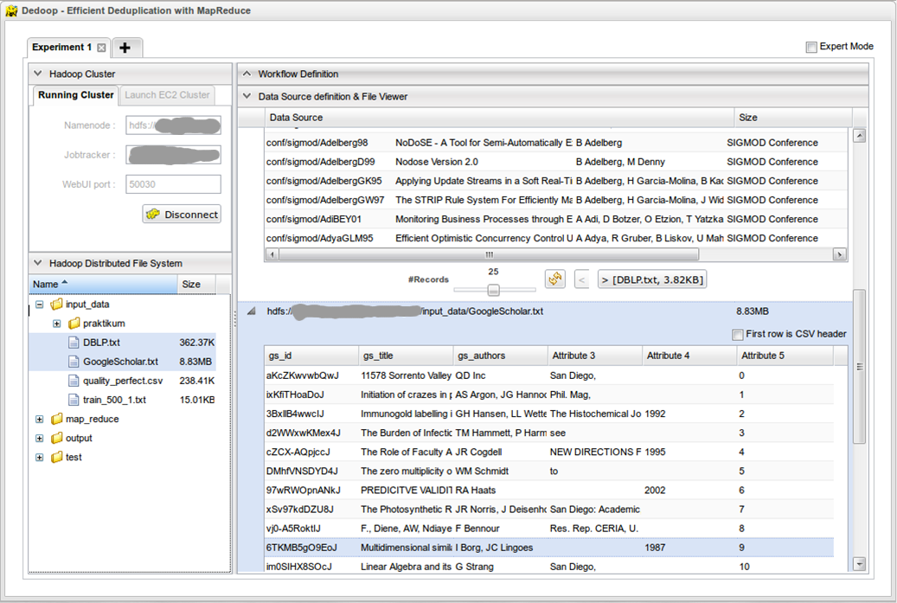
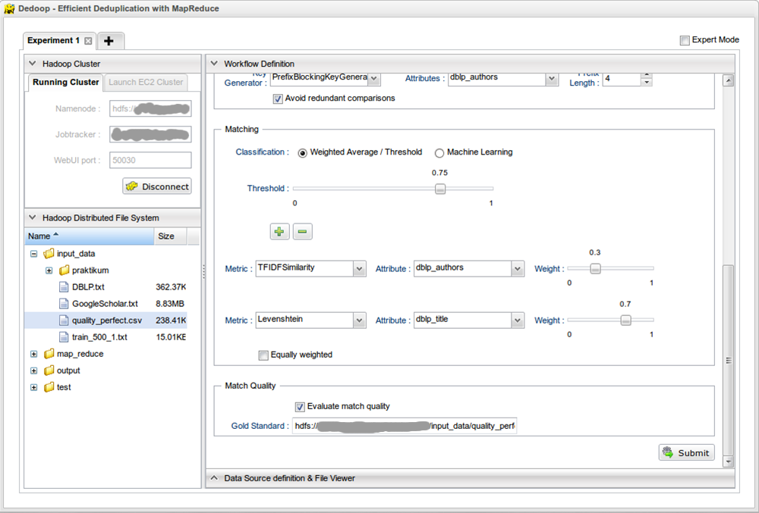
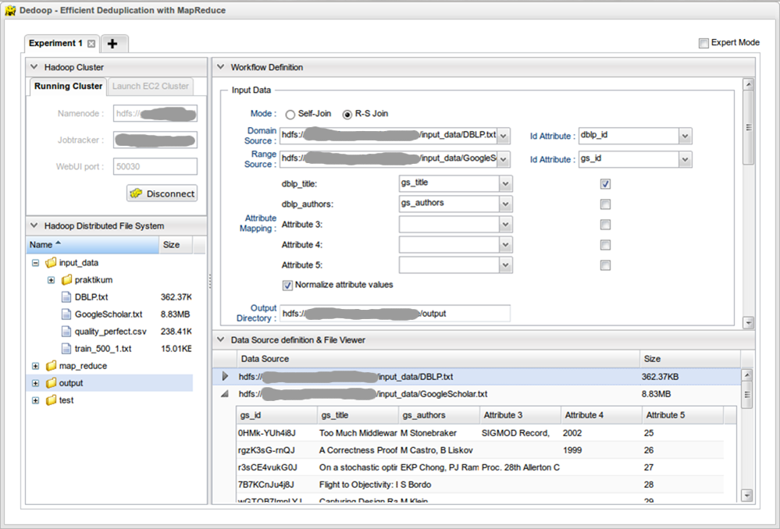
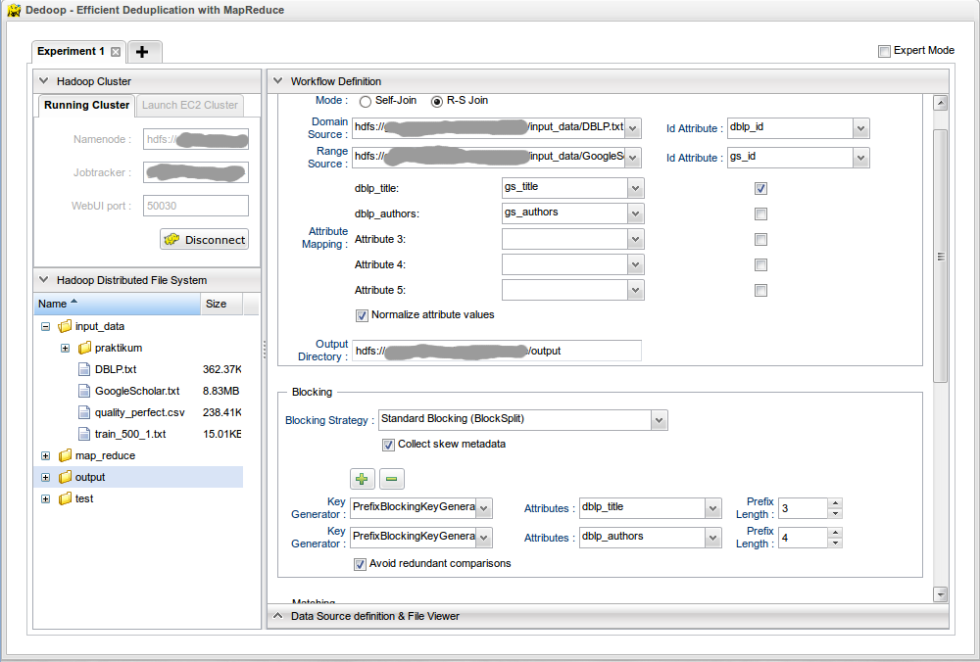
Browser-based workflow specification
Graphical HDFS file manager and File-Viewer
Support common file operations
Simple metadata operations to facilitates workflow definition
Input section
Select data sources, id attributes, final output directory
Attributes to appear in match result
Attribute mapping in case of two sources
Blocking Section
Standard Blocking, Sorted Neighborhood, Cartesian, Tokenset-Similarity
Blocking key generation functions
Matching section
Similarity Functions
Match classification (learning-based, threshold-based)
Notes:
Simultaneous handling of different (long-running) ER workflows that can connect to different Hadoop clusters

Slide 10
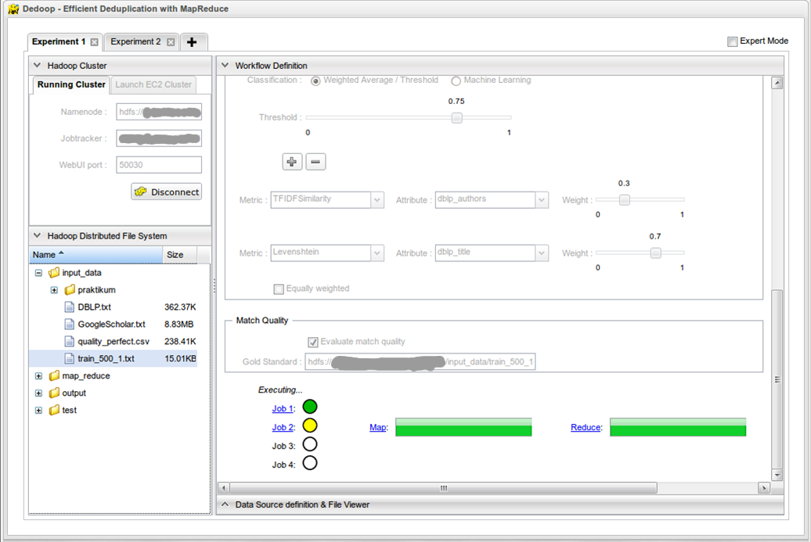
Workflow submission & progress monitoring
Automatic mapping of specified workflow to a sequence of MR jobs
Enrichment of corresponding JobConfs that the map/reduce function can access
“Usual” MapReduce parameters (input files, output directory)
Custom parameters (similarity function, attributes)
Dedoop can handle multiple (long-running) workflows that can connect to multiple clusters simultaneously
Client-side workflow submission is appended to a queue of outstanding workflows at serve side
Workflow executer consumes submitted workflows asynchronously
Clients periodically poll workflow executer for progress

Slide 11
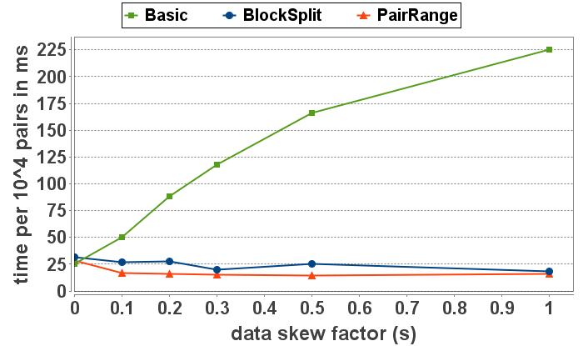
Load Balancing
Independent matching of individual blocks
Quadratic complexity of costly entity comparisons per block
Skewed block sizes lead to severe load imbalances in the reduce phase
Lower bound is the time required for matching largest block
Adding more nodes does not further speed up computation
Key Ideas
Additional MR job to determine blocking key distribution, i.e. number and size of blocks
Global load balancing that assigns nearly the same number of pairs to reduce tasks
[ICDE’12]: Load Balancing for MapReduce-bases Entity Resolution
BlockSplit: Split large blocks into sub-blocks
PairRange: Global enumeration and tailored distribution of entity pairs
Variation for Sorted Neighborhood [CSRD’12]
„Uniform distribution“
„All entities in a single block“

Slide 12
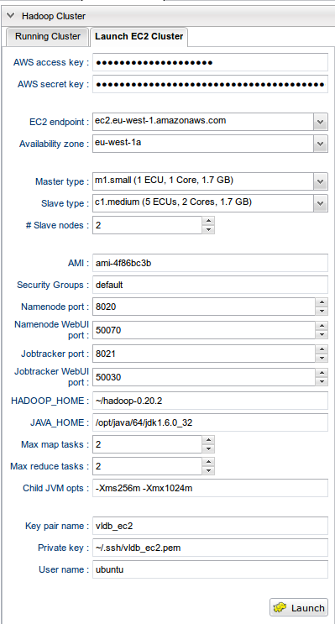
Hadoop@EC2
Large match problems → Amazon EC2
Launch n virtual machines of a specific type and “outsource” the computation of a specified workflow
Set-up of a working Hadoop cluster is a laborious task
Hadoop nodes need to “know” each other but IPs are unknow upfront
Dedoop supports
Automatic launching of EC2 VMS
Hadoop cluster configuration & startup
EC2’s use of internal IPs
Hadoop nodes communicate with each other via internal IPs (“for free”)
Breaks workflows submission & progress monitoring from “outside”
Dedoop dynamically spawns SOCKS proxy servers that allow access to EC2 nodes via ssh tunnels

Slide 13
Summary
Challenge
Fast and effective object matching for large, real-world (dirty) datasets
Cloud-based parallel blocking and matching
Straight-forward utilization of MapReduce possible
... but doing it efficiently requires some work
Dedoop for easy and efficient Hadoop-based matching

Slide 14
Thank you for your attention

